Slide 1


Tracking User Engagement Analysis

Slide 2
Project analysis slide 5
Project Overview
Project Objective: Analyze whether new additions to the platform (courses, exams, career tracks) have increased student engagement.
Company's Hypothesis: The first half of 2022 was expected to be profitable due to increased engagement from new features launched in late 2021.
Purpose of the Analysis:
Measure the effectiveness of the new features on increasing user engagement.
Compare various metrics to gauge the impact on platform usage.
Expected Outcome:
Understanding the relationship between new features and student engagement.
Insight into how engagement metrics can inform future platform improvements.

Slide 3



Objectives
Measure Platform Performance
3
Compare key metrics such as registrations, purchases, and refunds from January 2020 to June 2022 to understand the platform’s growth and profitability.
Analyze Student Engagement Trends
1
Examine changes in student behavior, including course completions, video watch time, and certificate issuance, to assess engagement levels before and after the new features were introduced.
Evaluate the Impact of New Features
Determine whether new platform features like career tracks, exams, and an expanded course library have increased user engagement.
Identify Patterns and Insights
2
Use data to uncover patterns in how students interact with the platform over time, especially focusing on Q2 2021 versus Q2 2022.
4

Slide 4
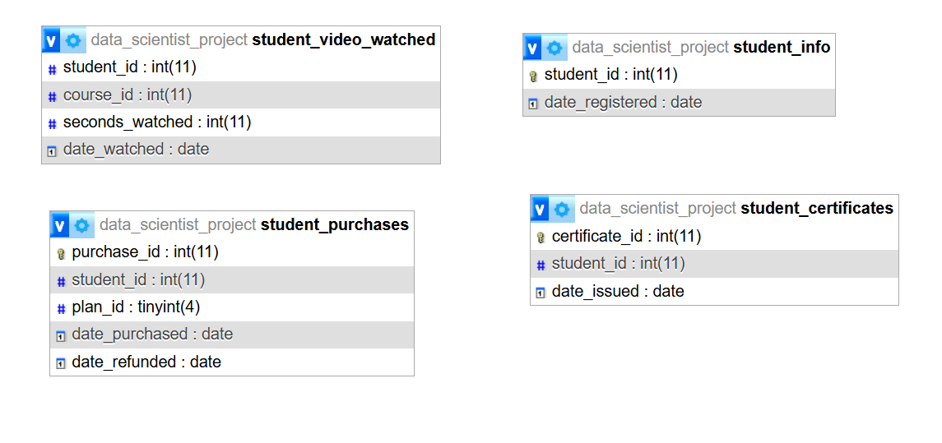
Project analysis slide 4
Table Structures

Slide 5
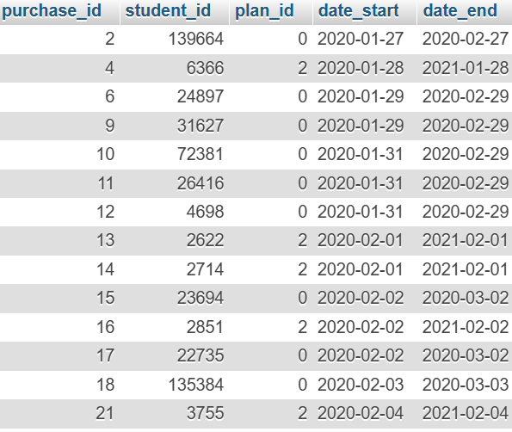
Project analysis slide 5
Data Preparation with SQL – Creating View
Objective:
Analyze the impact of new platform features on student engagement in Q2 2021 and Q2 2022.
Key Focus:
Subscription Tracking: Measure when students' subscriptions start and end, factoring in refunds.
Engagement Metrics: Calculate total minutes watched in Q2 2021 and Q2 2022.
Paid vs. Free Subscribers: Identify which students were paid subscribers in these periods.
Data Preparation Process:
Calculated Subscription End Dates:
Subscriptions adjusted based on plan type (Monthly, Quarterly, Annual) and refund dates.
Identified Paid Subscribers:
Created a view showing which students were paid in Q2 2021 and Q2 2022.
Aggregated Engagement:
Total minutes watched by students, categorized by paid or non-paid status.

Slide 6
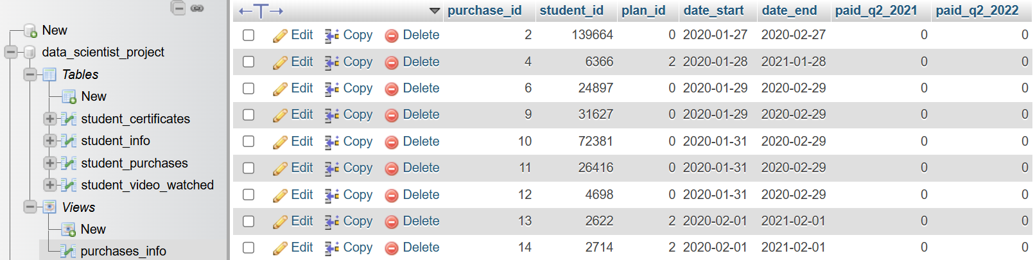
Project analysis slide 5
Engagement Insights and Results
Key Insights:
1. Total Minutes Watched:
Aggregated total minutes watched by students in Q2 2021 and Q2 2022.
Separated the analysis for paid and non-paid subscribers.
2. Paid vs. Non-Paid Engagement:
Created a binary “paid” column to track engagement based on subscription status.
The last column indicates whether a student had an active subscription in Q2 (represented by 1) or not (represented by 0).
Generated Datasets:
Students without Paid Subscriptions:
Q2 2021: 5,334 students
Q2 2022: 6,055 students
Paid Subscribers Engaged:
Q2 2021: 2,305 students
Q2 2022: 2,786 students

Slide 7
Project analysis slide 5
Analyzing Engagement with Certificates Issued
Objective:
Study the relationship between minutes watched and certificates issued to understand student engagement and performance.
Key Actions:
Target Students with Certificates: Focus on students who have been issued at least one certificate.
Calculate Engagement: For each student, calculate the total minutes watched and count the certificates issued.
If no minutes are recorded, assign 0 minutes.
Join Data: Combine information from the student_certificates and student_video_watched tables to aggregate the data.
Outcome:
The data provides insights into how students engage with content, specifically those who earned certificates.
The results are stored in minutes_and_certificates.csv for further analysis.
Sanity Check: 658 rows of data with students who have been issued certificates.

Slide 8
Project analysis slide 5
Data Analysis with Excel – Hypothesis Testing
Objective:
Evaluate the impact of new features on student engagement by analyzing minutes watched and performing hypothesis testing for free-plan and paying students in Q2 2021 vs. Q2 2022.
Key Insights:
1. Descriptive Statistics:
Calculated mean and median minutes watched for both groups.
Results align with distribution plots after removing outliers.
Highlighted changes in engagement between 2021 and 2022.
2. Confidence Intervals:
Derived 95% confidence intervals for each group using standard statistical methods.
Provided precise bounds for expected engagement metrics.
3. Hypothesis Testing:
Null Hypothesis (𝐻0H0): Engagement in Q2 2021 ≥ Q2 2022.
Alternative Hypothesis (𝐻1H1 ): Engagement in Q2 2021 < Q2 2022.
Separate t-tests conducted for free-plan (equal variances) and paying (unequal variances) students.

Slide 9
Project analysis slide 5
Business Outcomes
Business Outcome:
Significant findings indicate whether new features contributed to higher engagement in Q2 2022.
Discussed risks of Type I and II errors:
Type I (false positive): Higher cost due to misjudged feature success.
Type II (false negative): Missed opportunity to invest in impactful features.

Slide 10
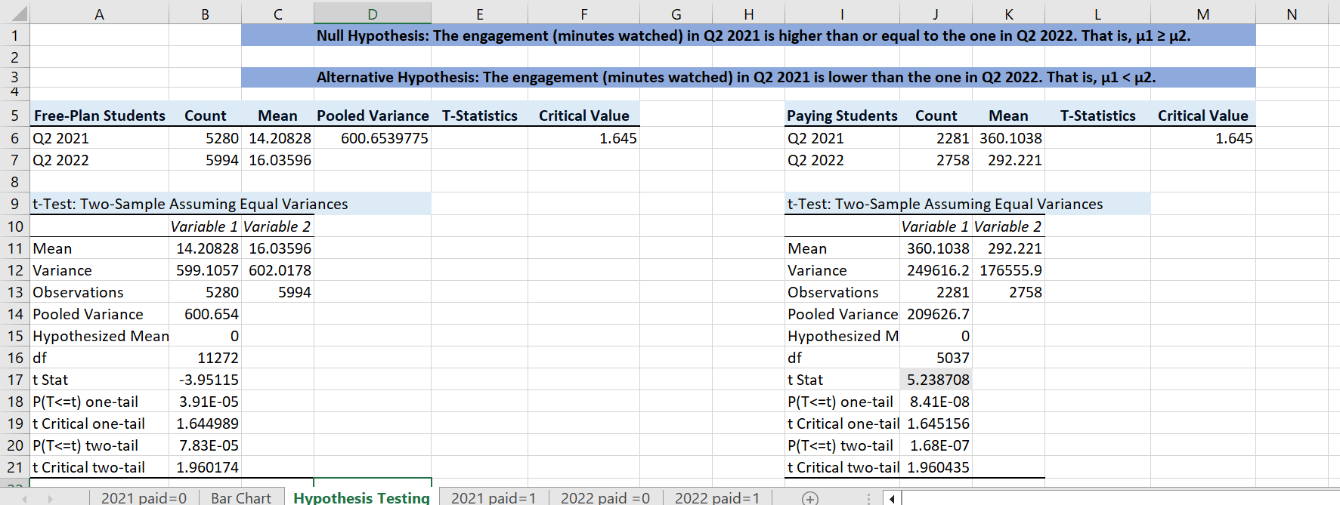
Project analysis slide 5
Business Outcomes

Slide 11
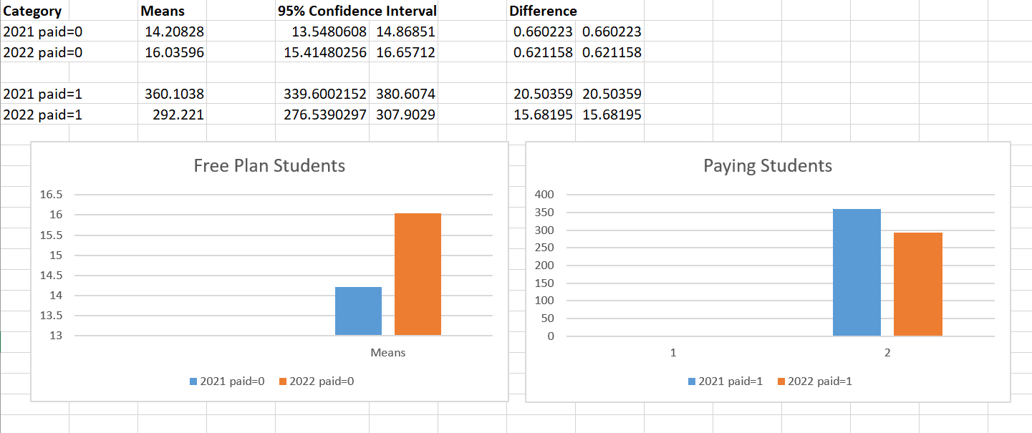
Project analysis slide 5
Business Outcomes

Slide 12
Project analysis slide 5
Dependencies and Probabilities
Calculating Total Minutes Watched
Retrieved total minutes watched by each student in Q2 2021 and Q2 2022.
Rounded the results to two decimal places.
Filtered data to only include relevant periods (Q2 2021 and Q2 2022).
Identifying Paid Subscriptions
Joined video-watching data with the purchases_info view to check if students had active subscriptions in Q2.
Created a new column, paid_in_q2, to identify students with paid subscriptions (1 for paid, 0 for free users).
Filtered the data into four groups:
Purpose:

Slide 13
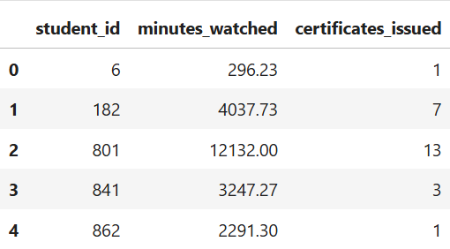
Project analysis slide 5
Linear Regression Insights: Student Engagement Analysis
This part aims to perform a linear regression using the minutes_watched column as a predictor and certificates_issued as a target. Having done that, answer the following:
What is the linear equation that explains the behavior of the relationship?
What is the R-squared value of the regression? How would you interpret it?
What is the predicted number of certificates taken by a student who has watched 1200 minutes of content? (Round your result up to the nearest integer.)

Slide 14
Project analysis slide 5
Linear Regression Insights: Student Engagement Analysis
Objective:
Predict the number of certificates issued based on minutes watched using Linear Regression.
Dataset Overview:
Input Variable: minutes_watched
Target Variable: certificates_issued
Data split: 80% training, 20% testing.
Model:
Linear Equation: 𝑦=1.056+0.001740⋅𝑥
R-squared Score: 0.305 (30% variability explained).
Key Insights:
Minutes watched correlates with certificates issued but isn’t the only factor.
Other factors: course lengths, prior knowledge, exam strategies.
Prediction Example:
For 1200 minutes watched, predicted certificates = 3.
Visualization:
Scatter plot shows actual vs. predicted values for testing data.
Conclusion:
Linear Regression provides insights but needs additional features for better accuracy.
Next Steps: Explore multi-factor and non-linear models.

Slide 15
Project analysis slide 10
Project Analysis
X-Axis (Targets): Actual number of certificates issued (real-world data)
Y-Axis(Predictions) – Predicted number of ceritificates issued by the model
Dots: Each dot represents a student's outcome.

Slide 16
Thank you

